Slide 1
Convolutional neural network interpretability for picture classification
-
Intermediate presentation (P3)
Sébastien David, Matthieu Desse, Antoine Hue, Romain Legrand
28, April 2020
Notes:
subject
partner : Ministère des Armées

Slide 2
Timeline
08/01/2020
First call with the Defense minister’s partner
28/04/2020
P3 presentation (remote)
11/2019
Project kickoff
04/02/2020
P2 presentation and first meeting with the partner
25/06/2020
Final restitution
Notes:
mention previous bibliographic works
paper : gradients based methods

Slide 3
Summary
Neural Embedding Viewer
Weights and gradients evolution
DNN viewer
Next steps
Back up slides
Notes:
In situ Visualization of Convolutional Neural Networks

Slide 4
Project status
After a bibliographic work, we have decided to propose a proof of conception, a prototype visualisation tool.
The aim is to visualise the training and the performance of a CNN for a task of picture classification.
Nota bene : we do not have any news from our partner since the last meeting (P2 presentation), that is why we have followed our own intuitions and wills.

Slide 5
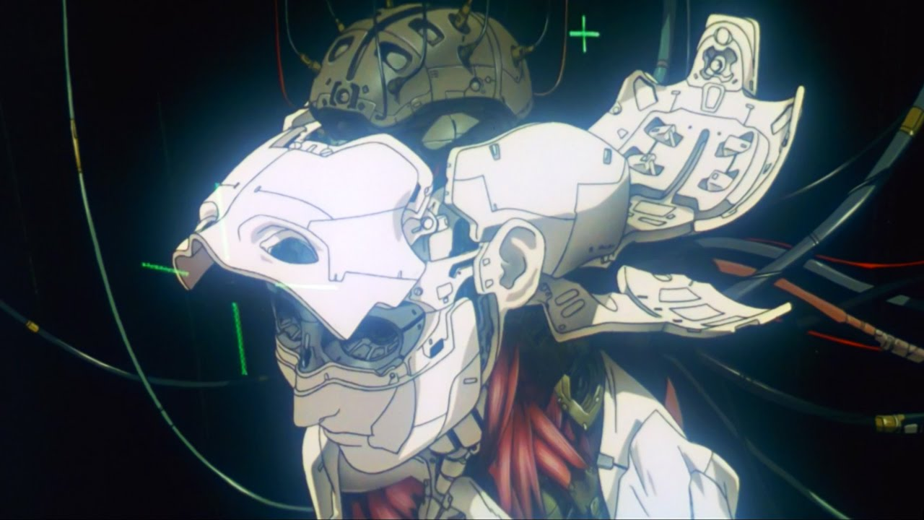
Neural Embedding Viewer
Inspecting the Hidden Representations learned by Deep Convolutional Neural Networks with dimensionality reduction
Training Phase Monitoring
(Post-Training) Model Interpretability

Slide 6
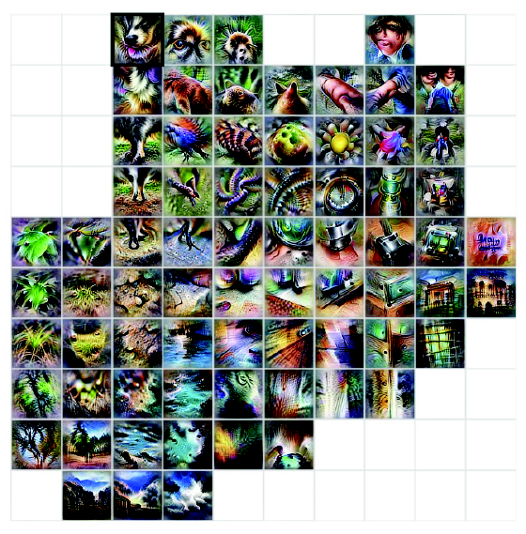
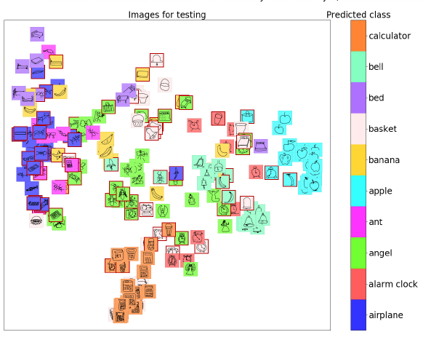
Neural Embedding Viewer
1.1. Motivation for embedding visualization
Source: Carter et al., 2019
Source: Peters et al., 2019

Slide 7
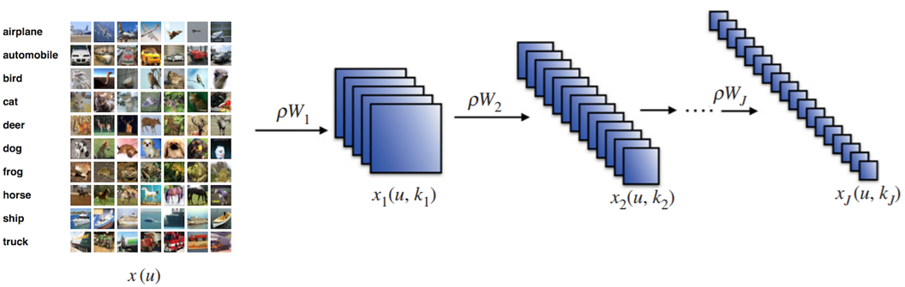
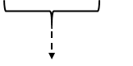
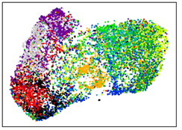
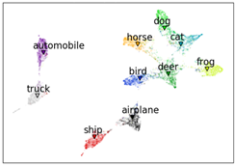
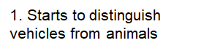
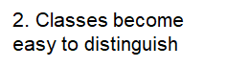
Neural Embedding Viewer
1.1. Motivation for embedding visualization
Neural Embeddings

Slide 8
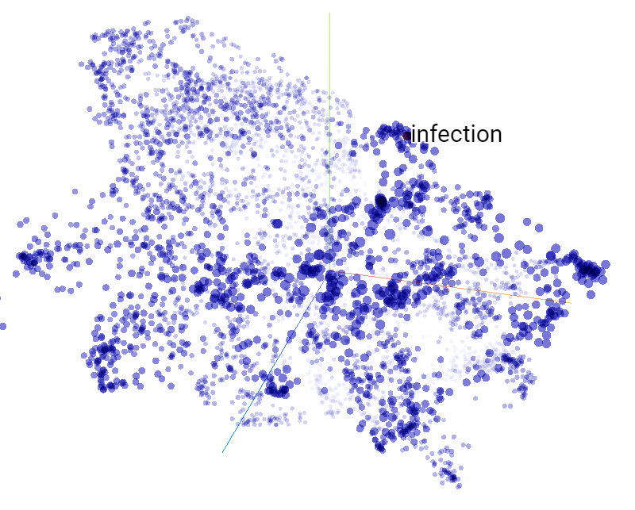
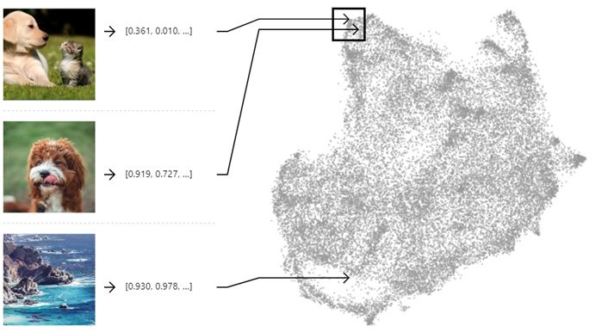
Neural Embedding Viewer
1.1. Motivation for embedding visualization
Extremely popular in NLP with Word Embeddings (e.g. Word2Vec, BERT, XLNet) and can also be used in Computer Vision.
Interpret / Audit Model Behaviour
How does it perceives similar or dissimilar images (e.g. dog breeds vs. oceanic terrain)?
AAA
Visualize neuron activity / inactivity
Class specialization (Rauber et al., 2017)
Existence of “dead regions” (Pezzotti et al., 2018)
Source: https://projector.tensorflow.org/
Source: Carter et al., 2019

Slide 9
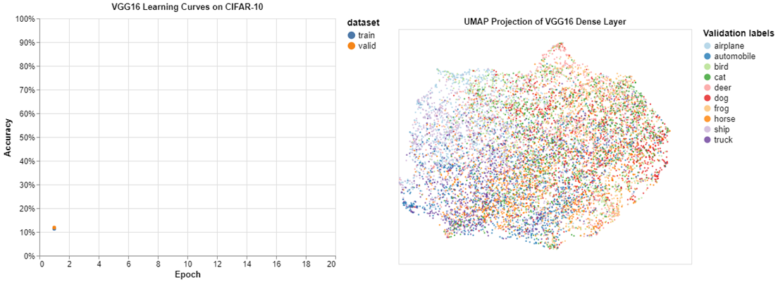
Neural Embedding Viewer
1.2. Demo: Training Phase of VGG-16 on CIFAR-10
Jupyter Notebook Experiments with Vega Altair

Slide 10
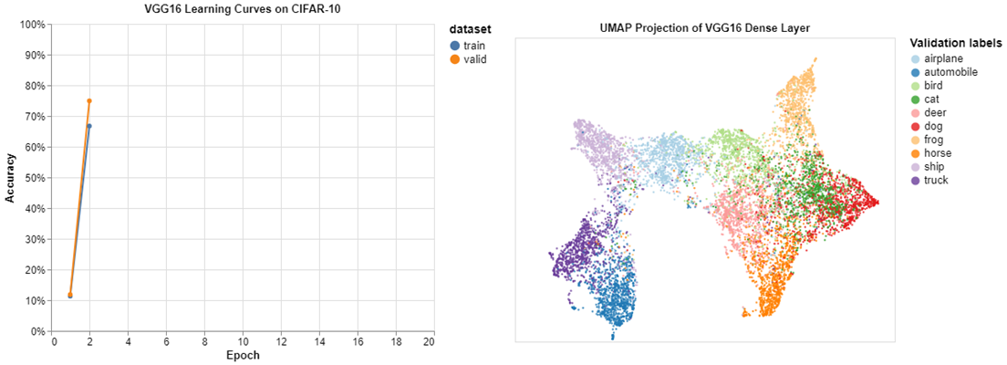
Neural Embedding Viewer
1.2. Demo: Training Phase of VGG-16 on CIFAR-10
Jupyter Notebook Experiments with Vega Altair

Slide 11
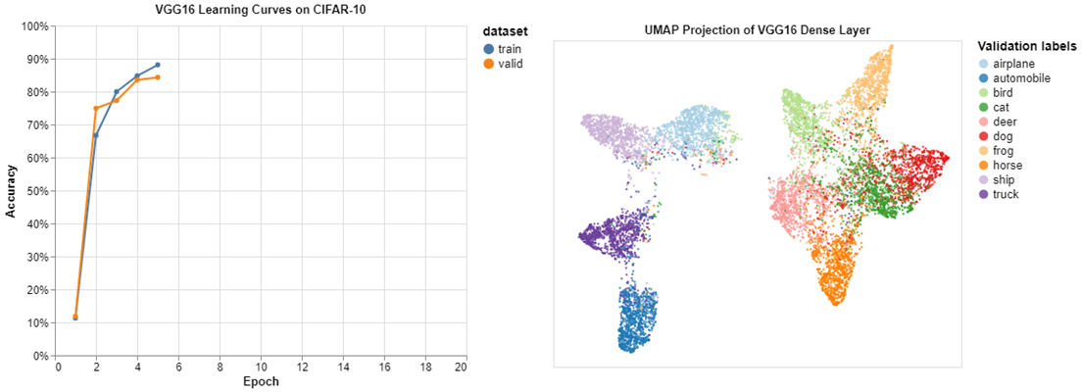
Neural Embedding Viewer
1.2. Demo: Training Phase of VGG-16 on CIFAR-10
Jupyter Notebook Experiments with Vega Altair

Slide 12
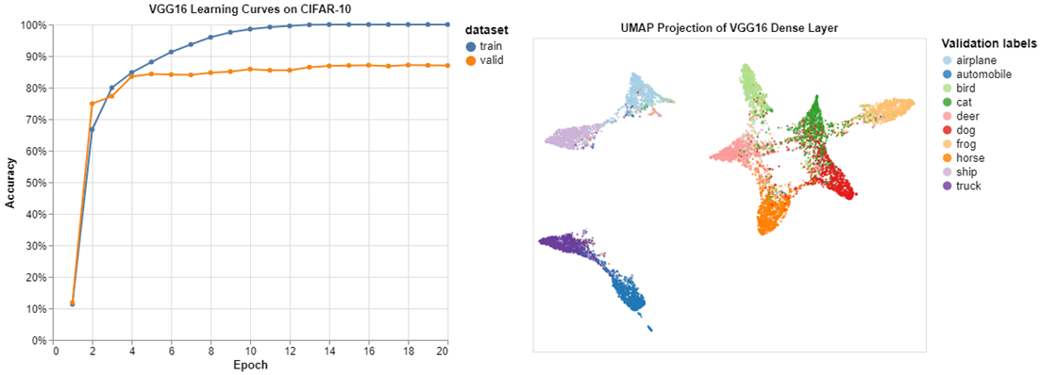
Neural Embedding Viewer
1.2. Demo: Training Phase of VGG-16 on CIFAR-10
Jupyter Notebook Experiments with Vega Altair

Slide 13
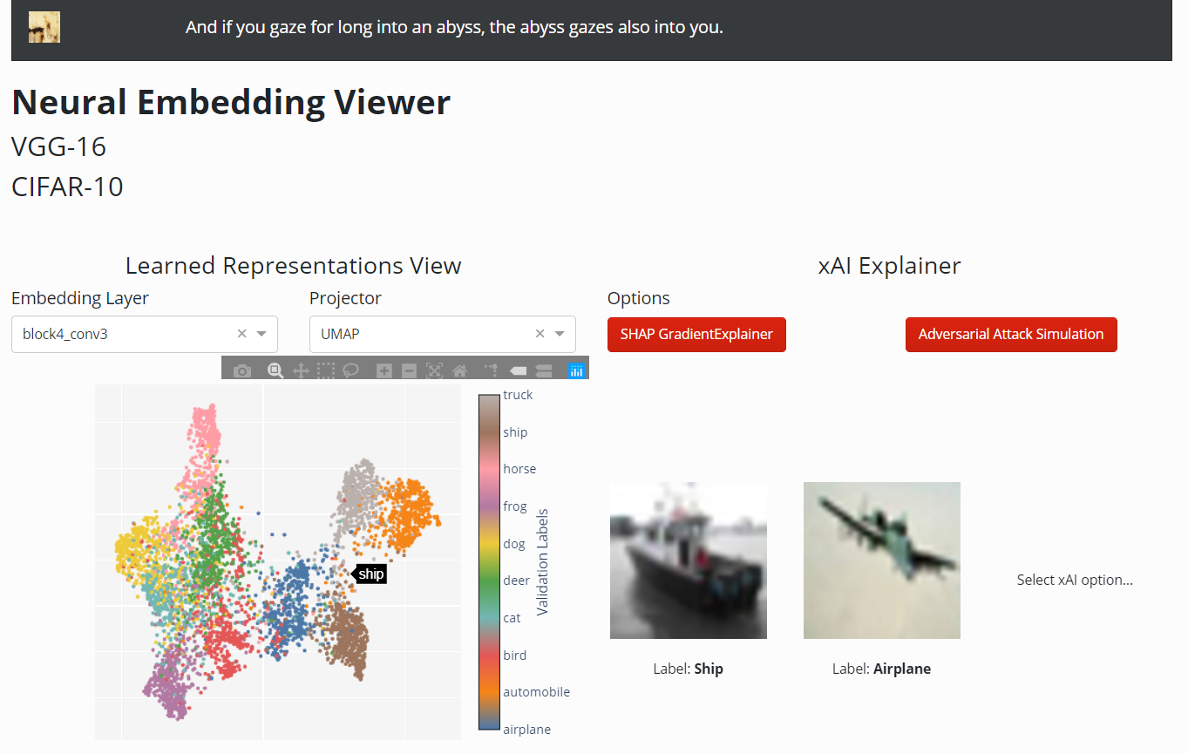
Neural Embedding Viewer
1.3. Devising an interactive solution
Scalability
A categorical colormap scheme will fail should the number of classes to predict becomes extremely high (e.g. CIFAR-100, ImageNet, Big Earth Net)
Interactivity
Give user choice for visualizing a particular embedding layer (unrealistic to display 16 different layers on a single screen)
Allow user to visualize the images or label relationships on the embedding scatterplot

Slide 14

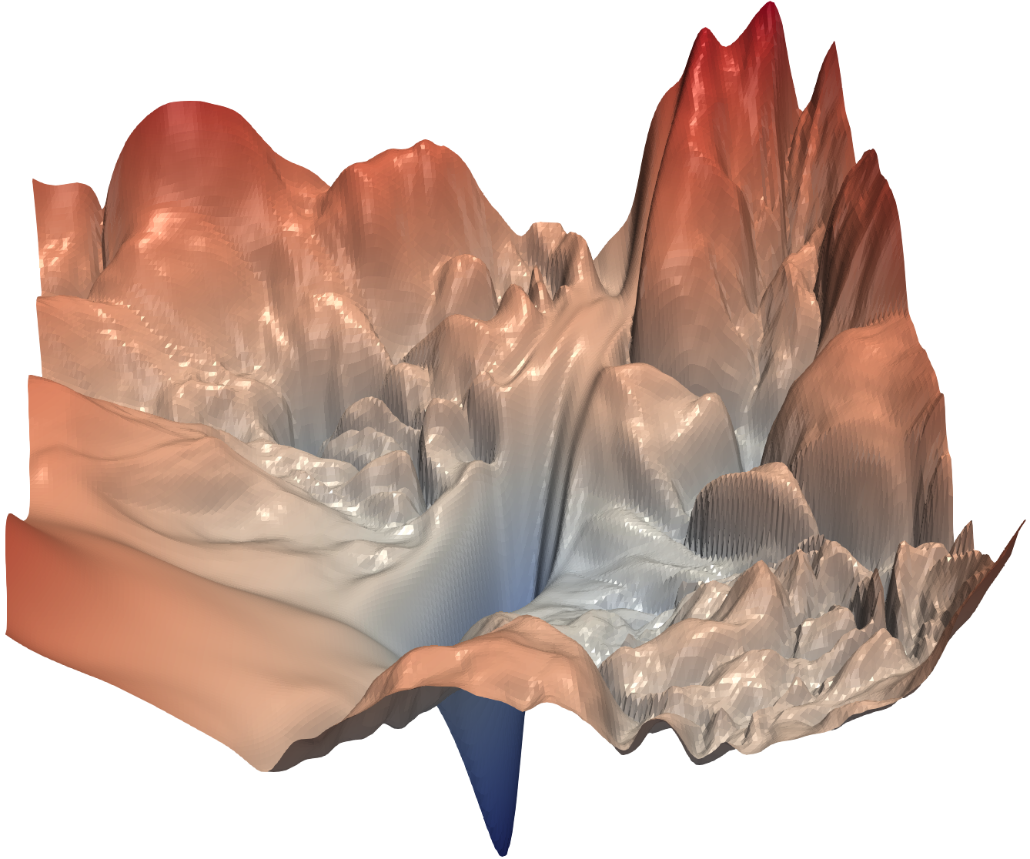

Neural Embedding Viewer
1.3. Devising an interactive solution
During Training
Post-Training (Explainable AI)

Slide 15
Preliminary prototype with Dash

Slide 16
Weights and gradients evolution
Visualise custom weights and gradients based metrics

Slide 17
Observations and Intuitions
Gradient and weights are two main concepts in DNN (forward and back-propagation).
The aim is to create several custom metrics to visualise :
the evolution for a unit (layer or neuron…),
the main activation areas of our CNN.
The custom metrics are the following :
basic values of accuracy
basic values of gradients and weights,
difference between 2 epochs (grads and weights)

Slide 18
Interactive Demo

Slide 19
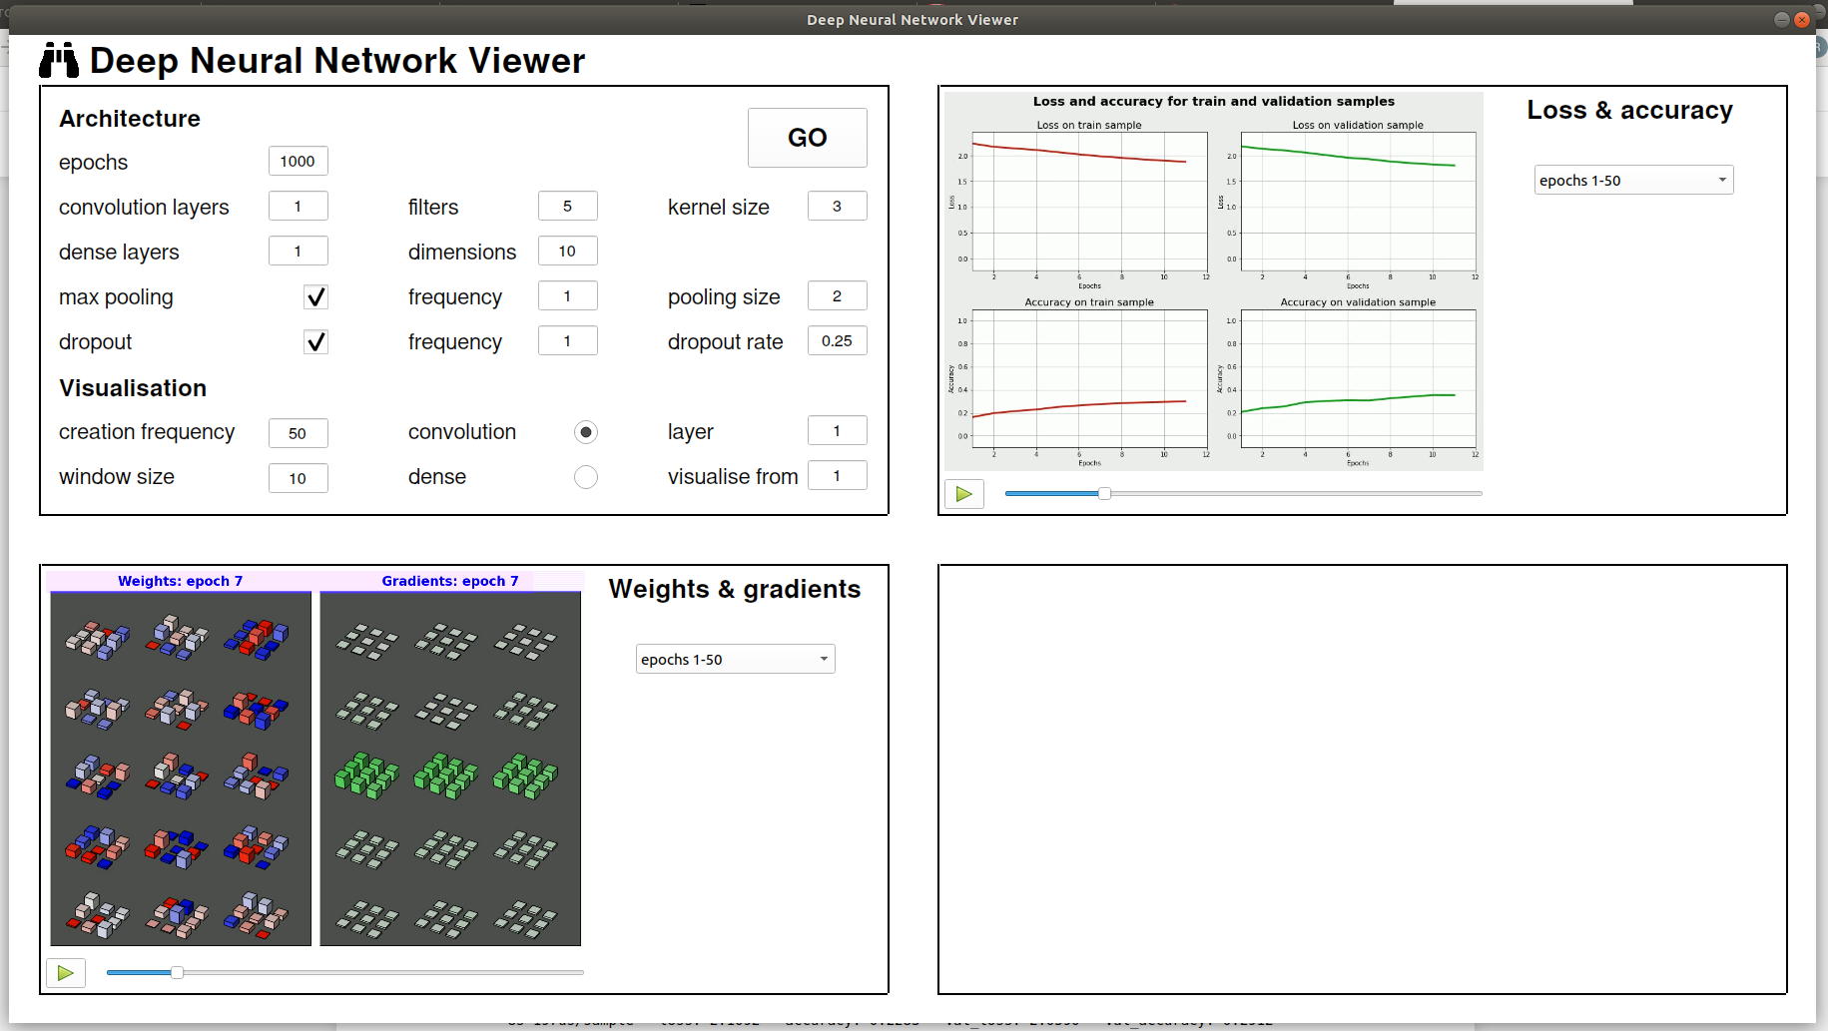
A GUI splits into 4 parts
Visualise evolution of training/validation loss and accuracy
Define an architecture
1
2
Visualise activation and correlation between filters
(to be developed)
Visualise weights and gradients evolution
3
4

Slide 20
DNN Viewer
Inspection of architecture, learnt parameters, and performance over epochs

Slide 21
Observations and Intuitions
Most techniques presented in the bibliography are assuming a layer or unit has been selected
A graphical user interface to click and select units would be very helpful
Each unit should be evaluated with test data (e.g. activation, saliency) and within the network graph
The user interface will allow navigation up and down the graph
Even the consolidated views over a dataset (e.g. t-SNE, UMAP) require layer/unit selection

Slide 22
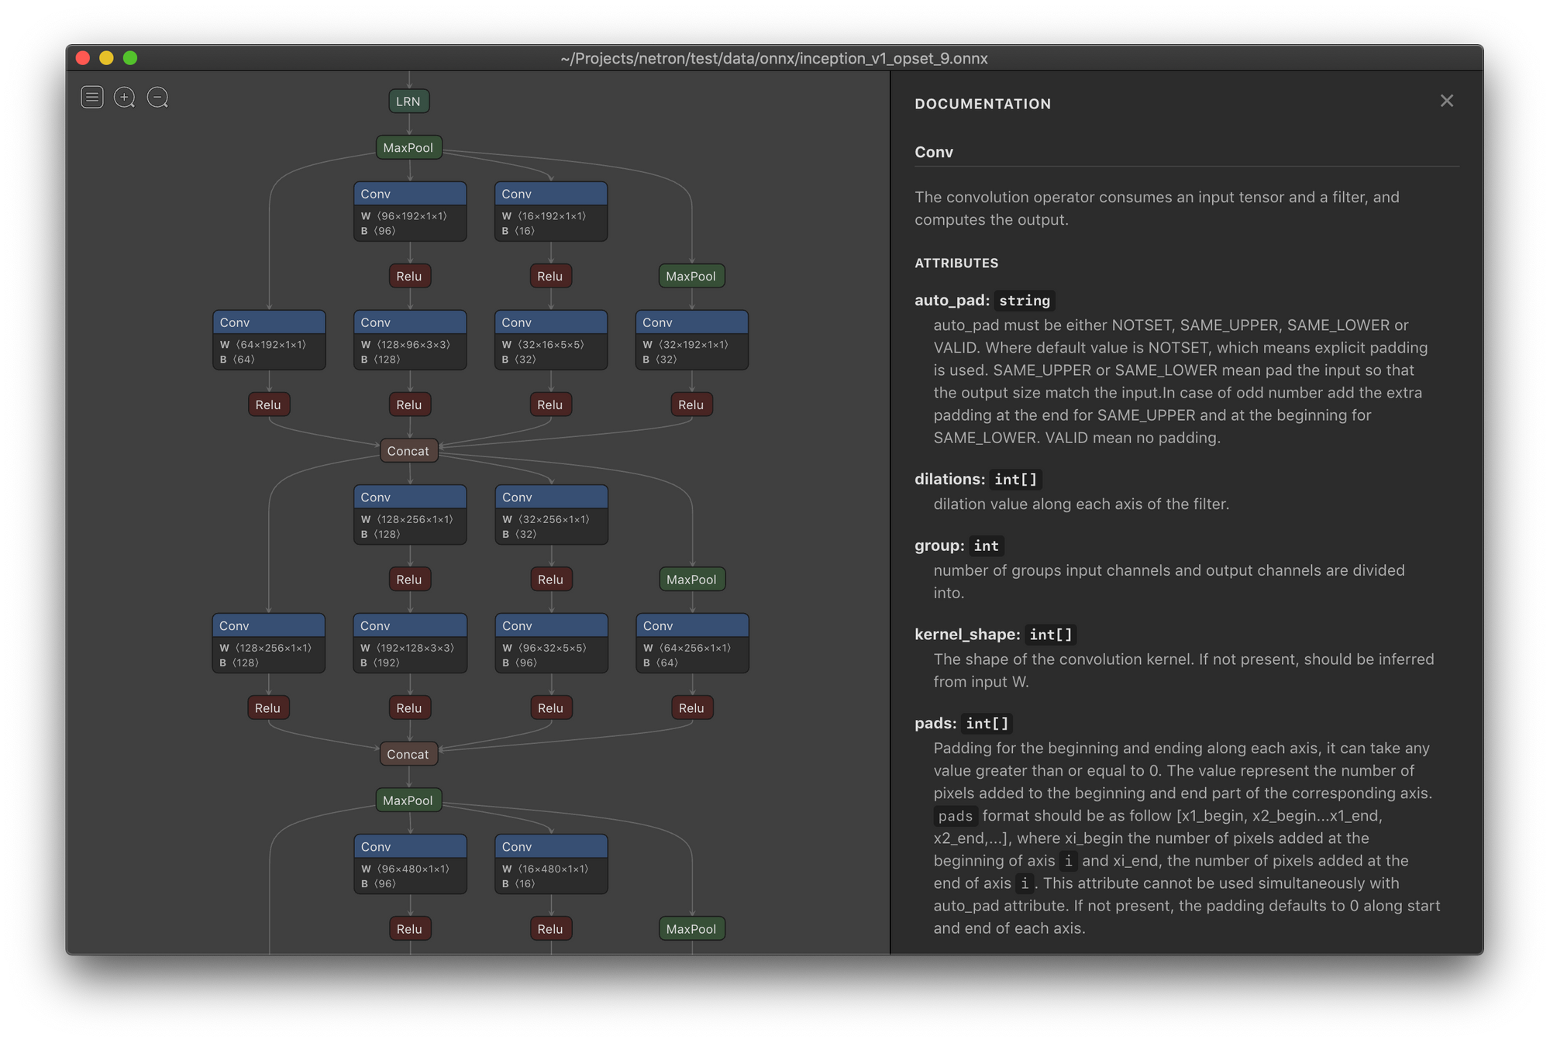
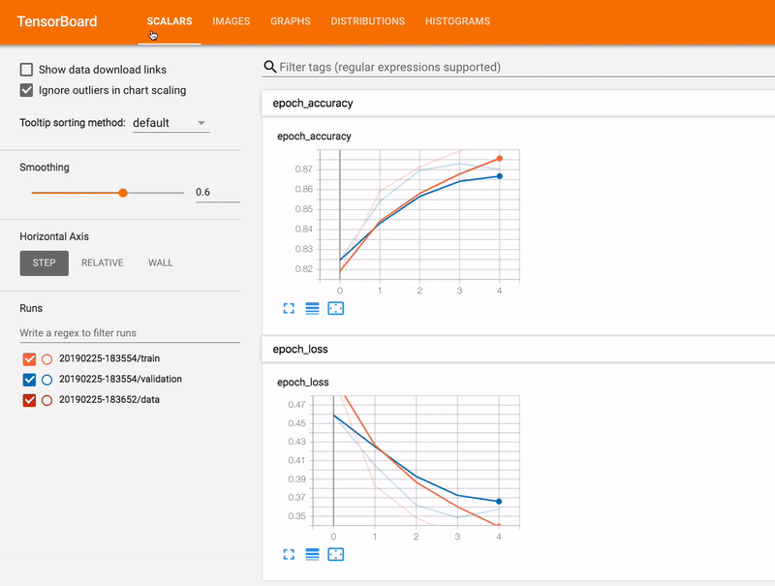
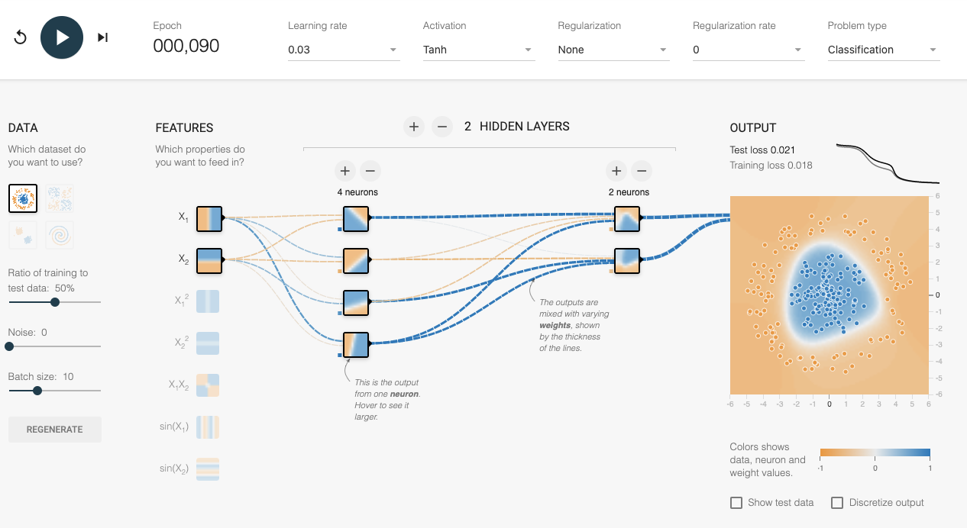
Netron
Tensorboard
playground.tensorflow.org

Slide 23
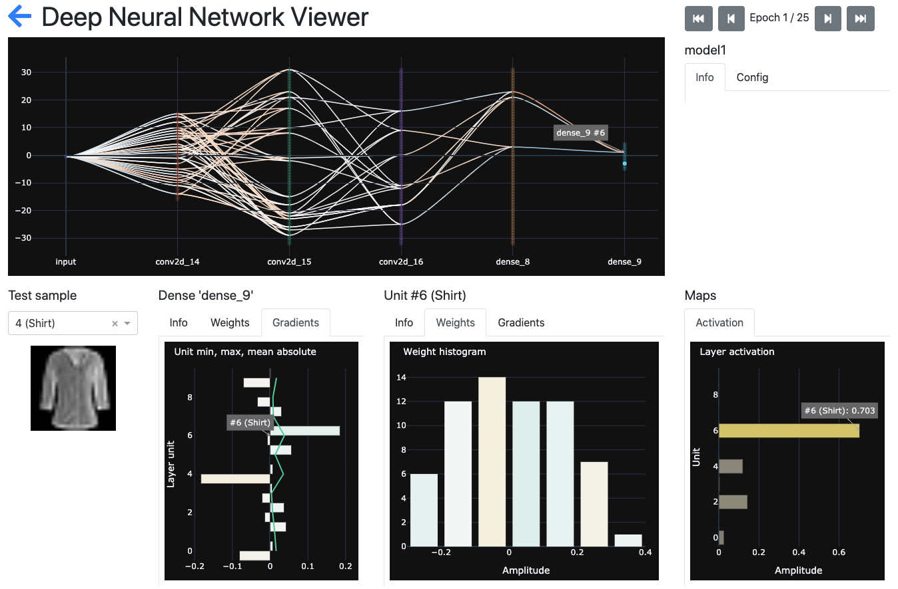
Deep Neural Network Viewer https://github.com/tonio73/dnnviewer
A graphical user interface to inspect:
architecture,
learnt parameters
gradients
of a deep neural network
$ pip install dnnviewer

Slide 24
DNN Viewer software stack
DNN Viewer
DNN Viewer application
Dash
Dash components
Dash Bootstrap components
Flask web server
Plotly
React.js
Plotly.js
Python runtime
Browser (JS runtime)
Serveur
Client

Slide 25
Interactive Demo
DNN Viewer

Slide 26
Use cases
DNN Viewer

Slide 27
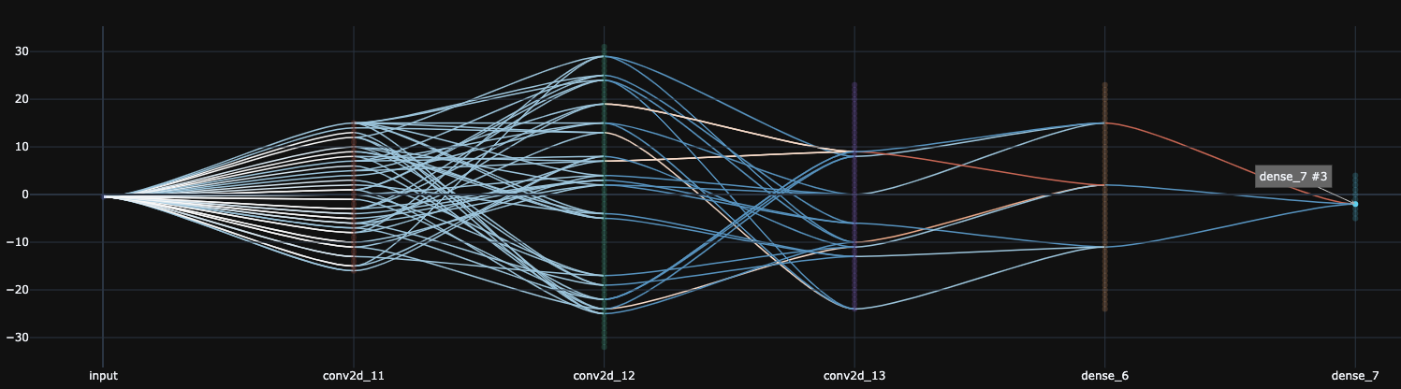
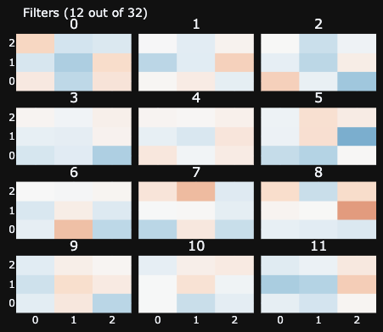
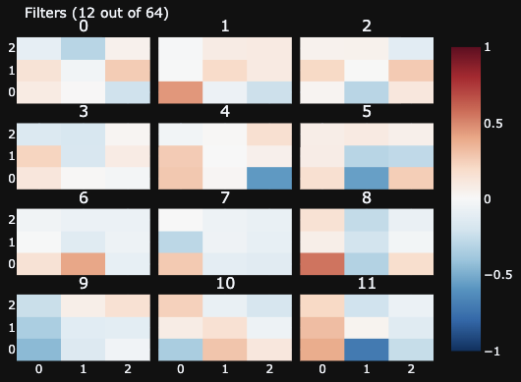
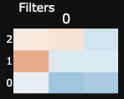
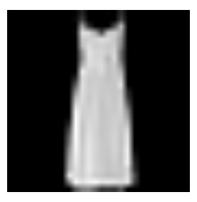
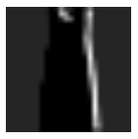
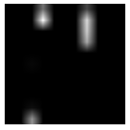

DNN Viewer forward activation
Fashion MNIST classification
3 convolutional layers
2 dense layers
Accuracy ~92%
Conv #1
Conv #2
Conv #3

Slide 28
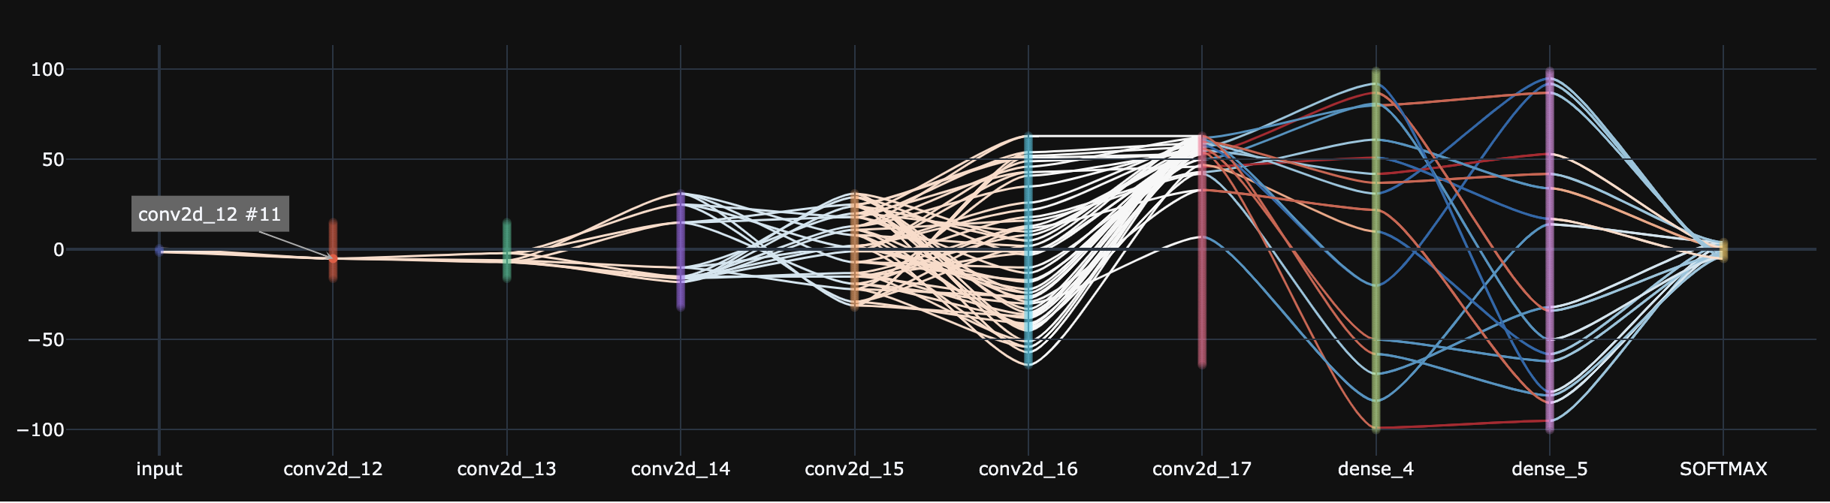

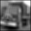
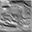
DNN Viewer forward on deeper network
CIFAR-10 classification
6 convolutional layers
3 dense layers
Accuracy ~85%
Conv #1
Unit #13
Conv #2
Unit #1
Conv #3
Unit #23
Conv #4
Unit #26
Conv #5
Unit #17
Conv #6
Unit #43

Slide 29
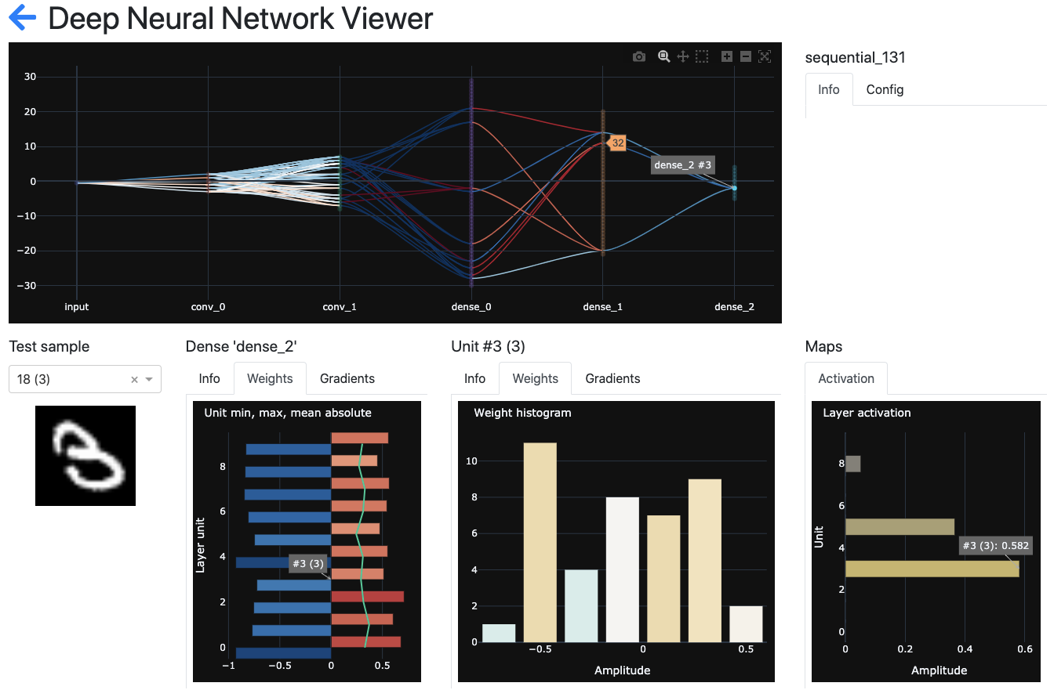
Backward inspection
Starting from an output, a target class, inspect the neurons in previous layers contributing positively or negatively to the activation on this class, given an input sample

Slide 30
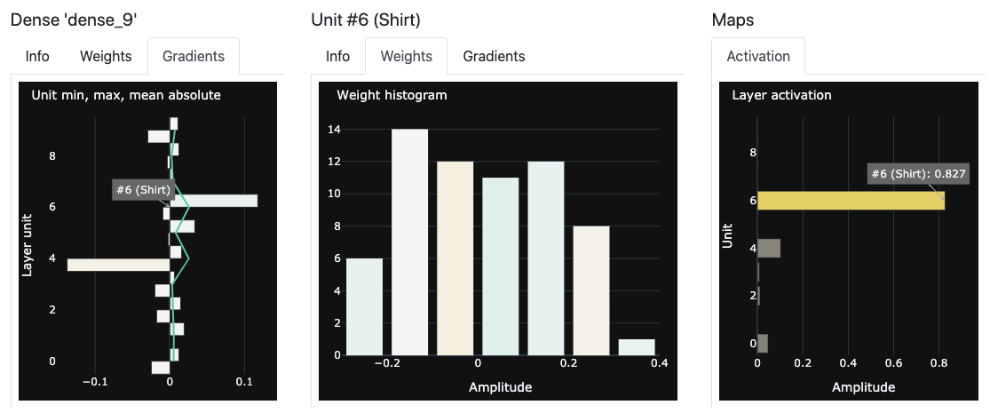
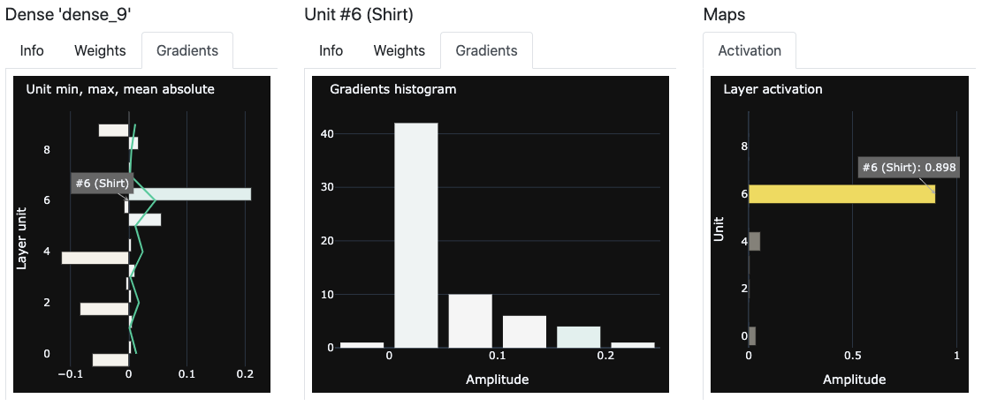
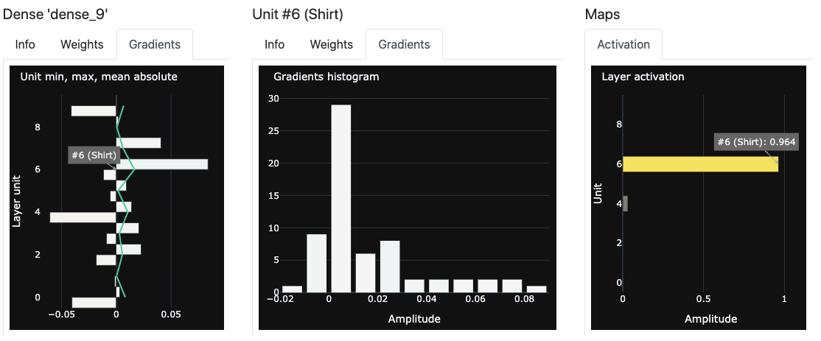
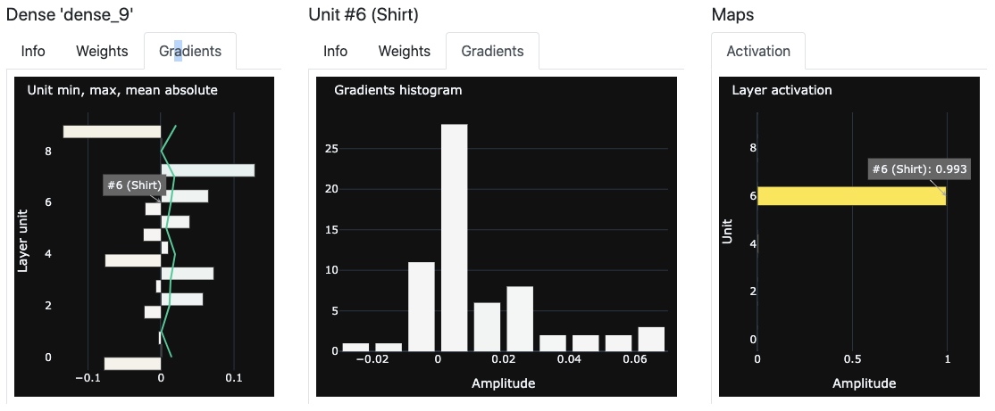
Inspection over epochs
Inspect activations, weights and gradients over epochs
Epoch 2
Epoch 5
Epoch 15
Epoch 25

Slide 31
Next Steps

Slide 32
Last steps before final restitution
The developed tools are of interest for pedagogical teaching and professional use
We have decided to carry on the development of each tool and implement new functions.
Moreover, we want to focus on the data visualisation which represents a large part of project and fundamental lecture this quarter through :
having a tool with comprehensive functions,
developing an interface more interactive,
ensuring a good user experience (feedbacks, beta-testing).

Slide 33
Backup slides

Slide 34
DNN Viewer architecture 1
main
Dash app
Flask server
widgets.
Router
Grapher
bridge.
AbstractModelSequence
Implement
pages[] : AbstractDashboard
layers[] : layers.AbstractLayer
bridge.
KerasModelSequence
Implement
Implement
main_model_selection
main_network_view
layers.Convo2D
layers.Dense
layers.Input

Slide 35
DNN Viewer layer connection plot
Continue backward with active list
Connected unit become “active”
Selected
Unit
Continue forward with active list

